Slide 1
DATA CURATION PROJECT
GROUP -21
D. SAMANTA
V. LALITHA
R. NITHIN
12 - 01 - 2023

Slide 2
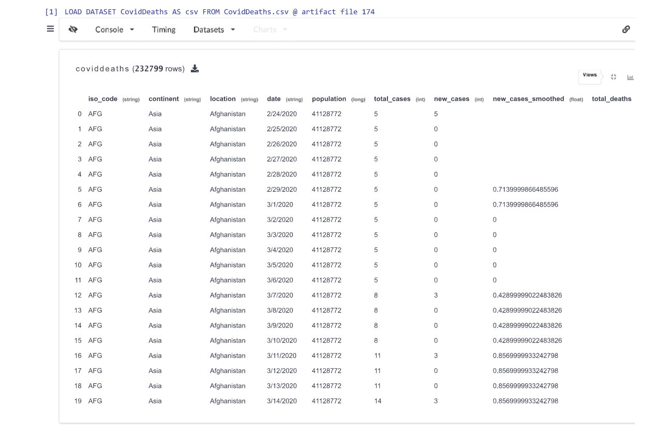
Loading DataSet into the VizierDB

Slide 3
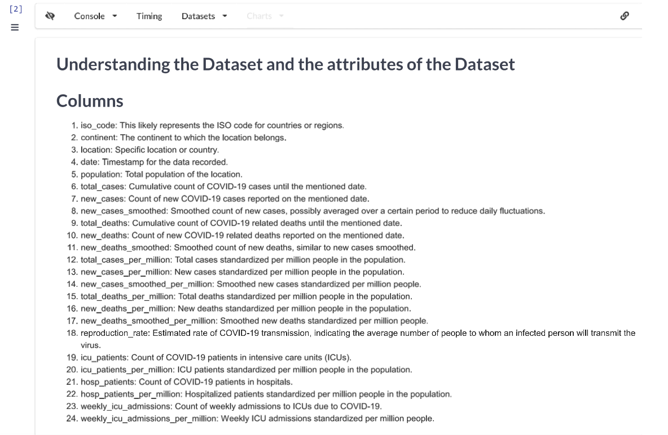
Columns of the DataSet

Slide 4
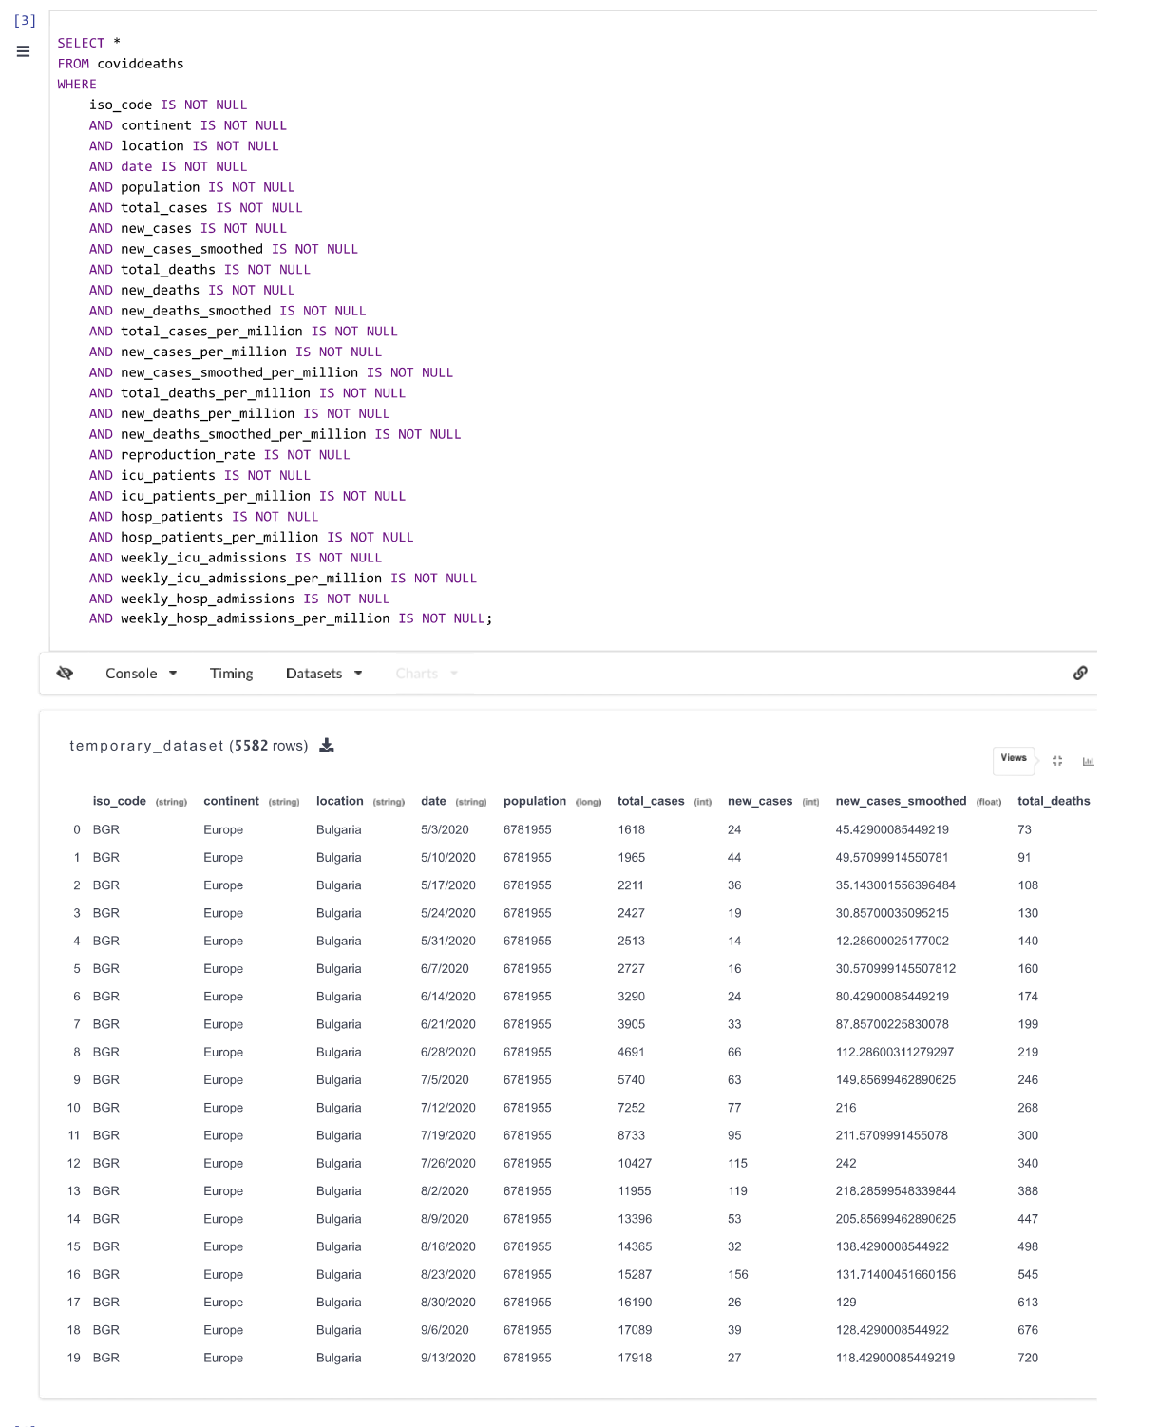
Query No. 1
This SQL query is a SELECT statement used for retrieving the data from the table named as ‘coviddeaths’ under the certain conditions specified by the WHERE clause.

Slide 5
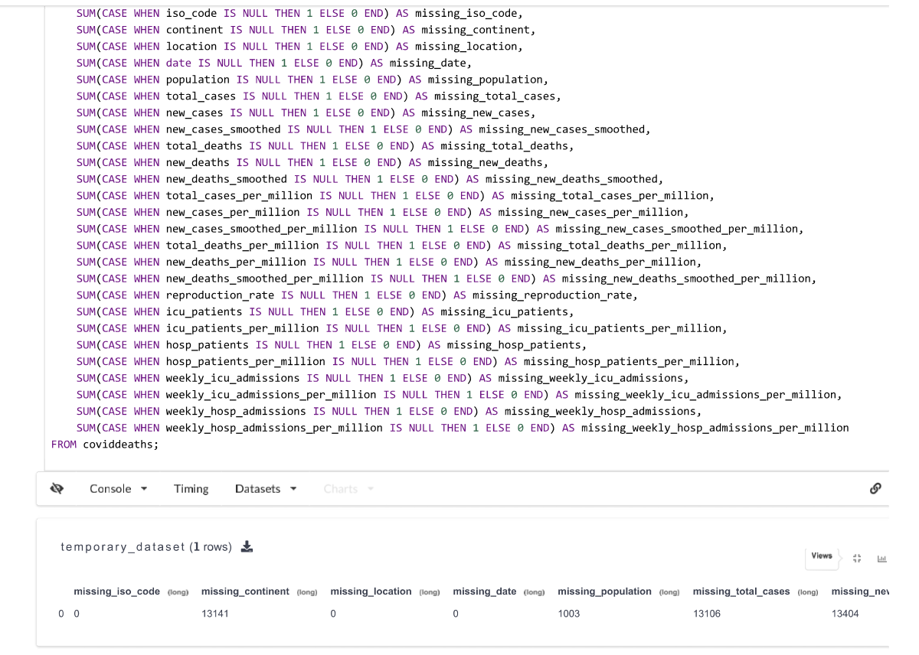
Query No. 2
The query assigns aliases (missing_iso_code, missing_continent, etc.) to the resulting counts for better readability in the output.

Slide 6
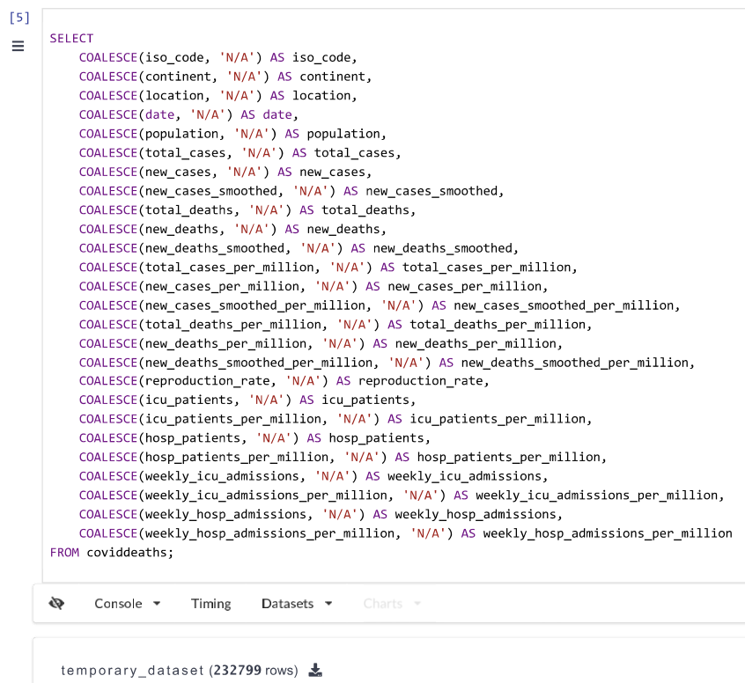
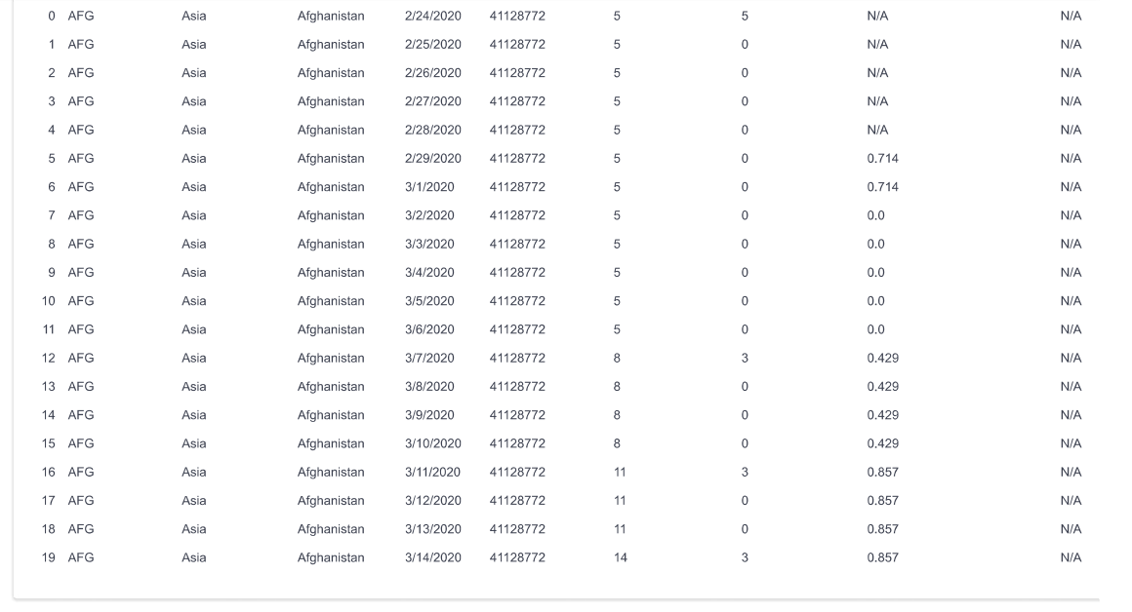
Query No. 3
The query returns the result set where each column contains the original data from the coviddeaths data table. However, if any of the columns had the null values, they will be replaced by 'N/A' as specified in the above function.

Slide 7
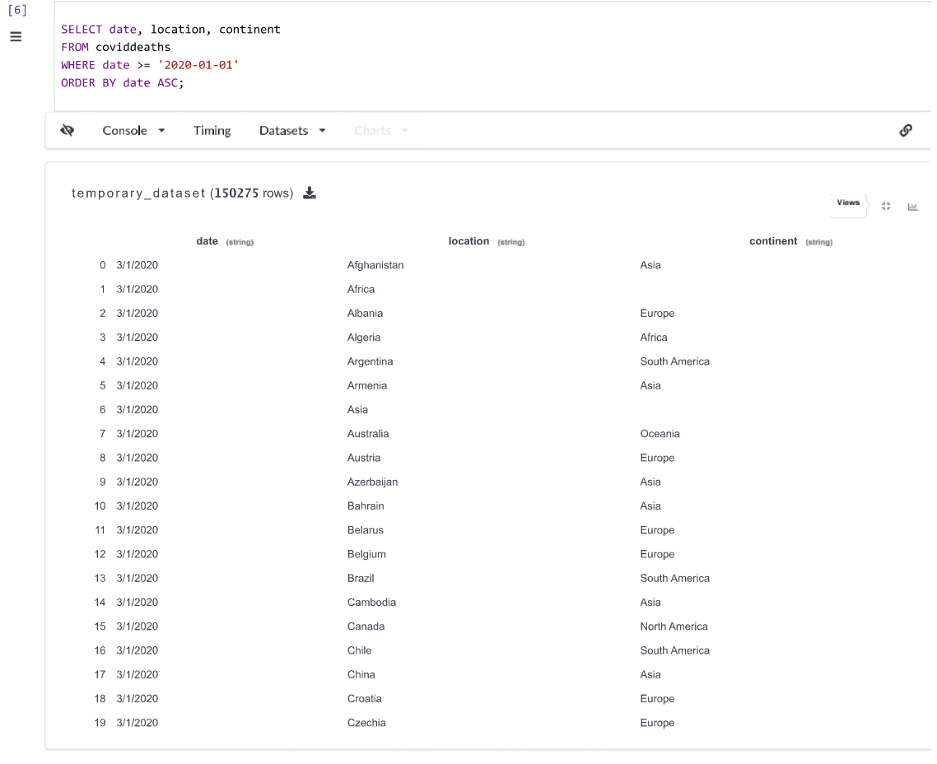
Query No. 4
This query aims to extract specific information regarding the date, location, and continent from the coviddeaths table, specifically focusing on entries from January 1, 2020, onwards. The retrieved data is then sorted in chronological order based on the date column, providing a chronological view of the COVID-19-related data by location and continent starting from the specified date.

Slide 8
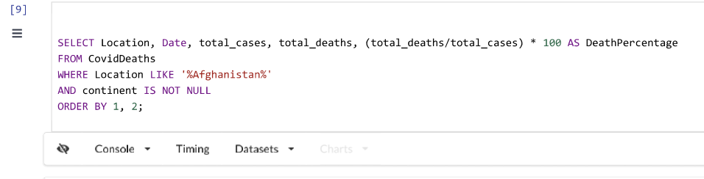
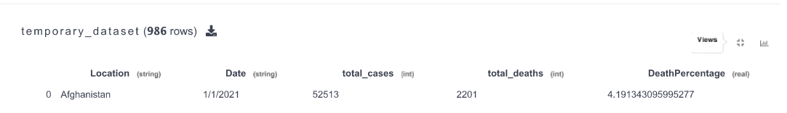
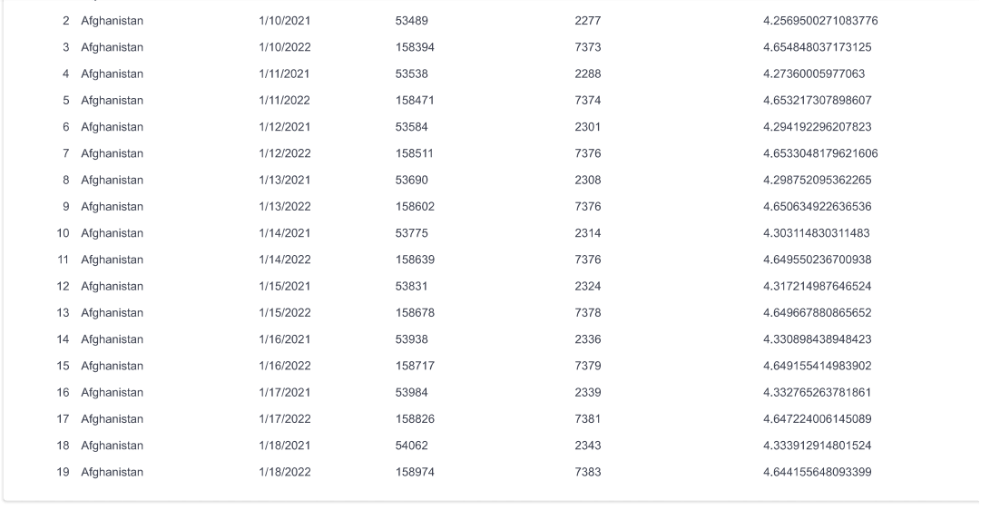
Query No. 5
This SQL query retrieves specific data from the ‘CovidDeaths’ table for the location 'Afghanistan'. It focuses on the location 'Afghanistan' and calculates the death percentage by dividing total deaths by total cases and multiplying the result by 100. The results include the location, date, total cases, total deaths, and the calculated death percentage. The final output is sorted by location and date in ascending order.

Slide 9
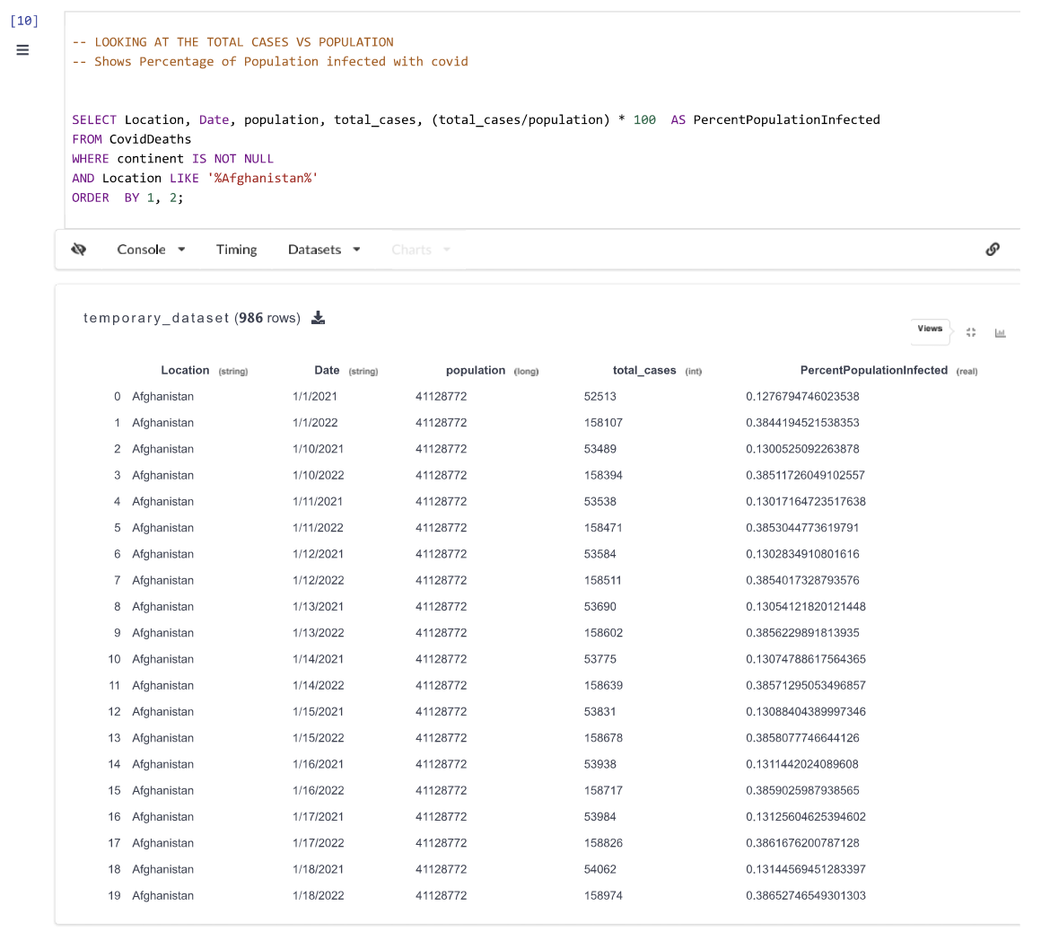
Query No. 6
Retrieves data from the ‘CovidDeaths’ table specifically focusing on the location 'Afghanistan'. It calculates the percentage of the population infected with COVID- 19 by dividing the total number of cases by the population of Afghanistan and multiplying the result by 100.

Slide 10
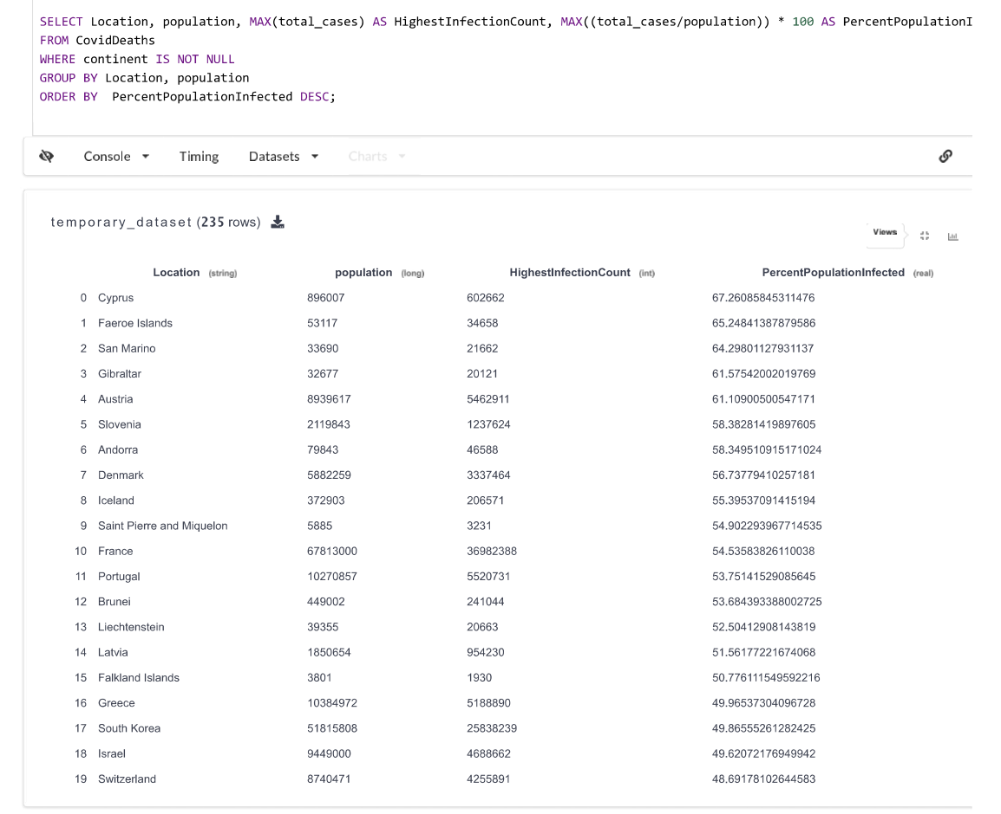
Query No. 7
Query identifies countries from the ‘CovidDeaths’ table with the highest infection rates concerning their population. It calculates the maximum total cases for each country, retrieves the corresponding population, and computes the percentage of population infected by dividing the maximum total cases by the population and multiplying by 100. The results are grouped by location and population, displaying columns for location, population, highest infection count, and the percentage of the population infected.

Slide 11
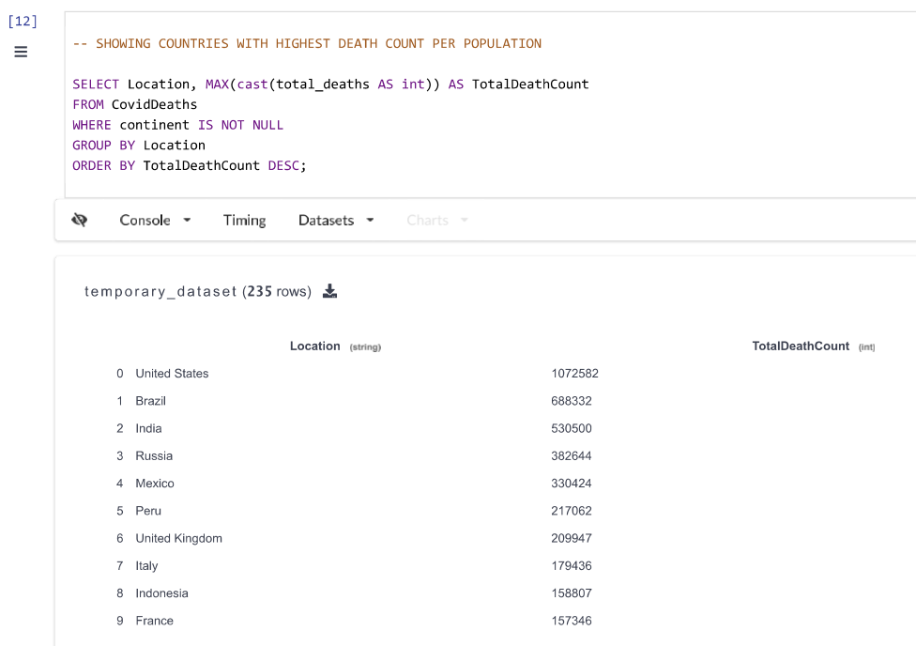
Query No. 8
Display the countries with the highest death counts. It calculates the maximum total death count for each country, considering the deaths reported. The results are grouped by location (country) and display columns for location and the maximum total death count. The final output presents the countries sorted in descending order based on their respective highest death counts.

Slide 12
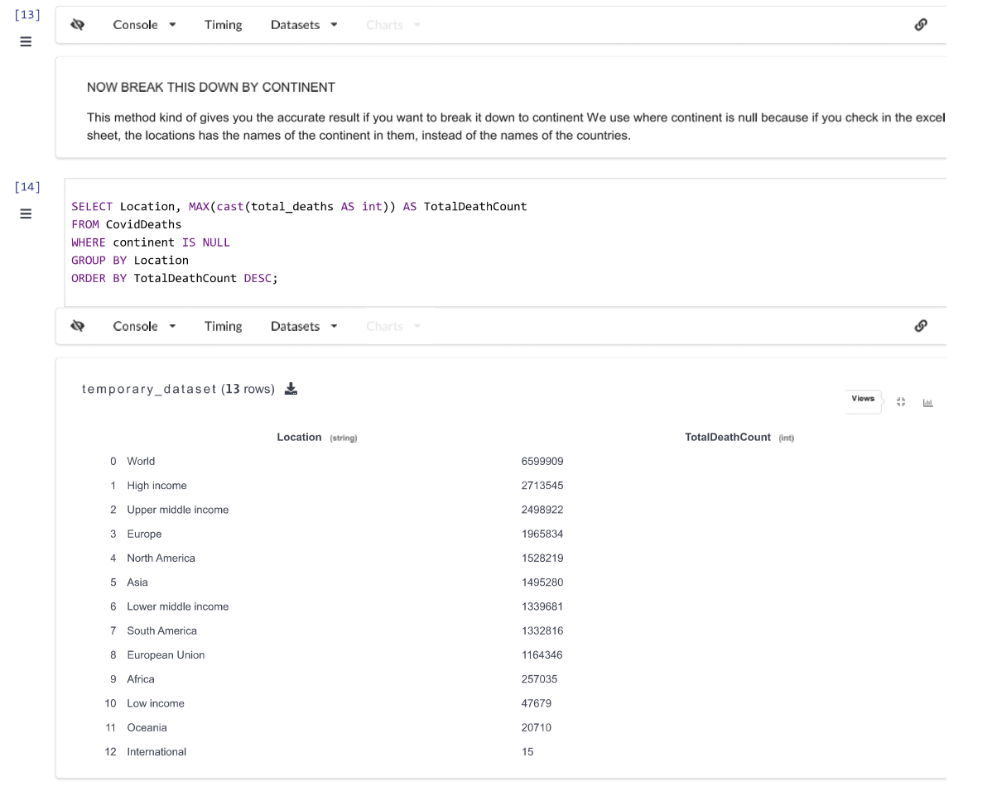
Query No . 9
Show locations (countries or regions) with the highest death counts where the continent value is NULL. It calculates the maximum total death count for each location in the dataset where the continent is not specified. The results are grouped by location and display columns for location and the maximum total death count.

Slide 13
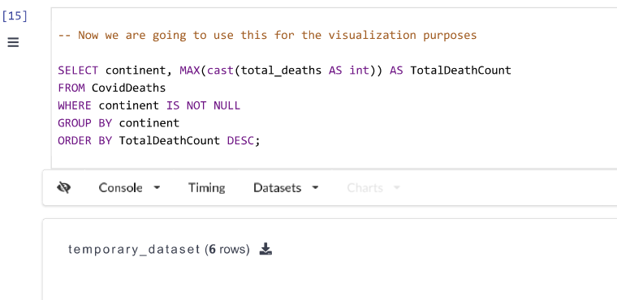
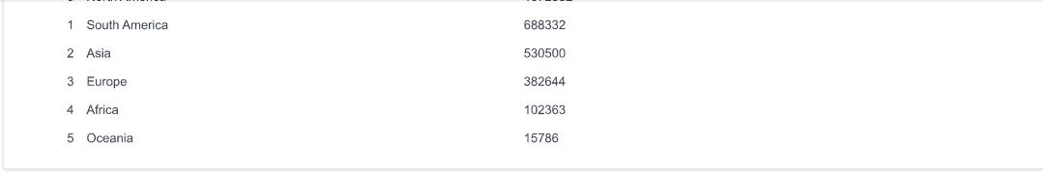
Query No. 10
Calculates the maximum total death count within each continent where the continent value is not null. The results are grouped by continent and display columns for continent and the maximum total death count recorded within each continent. The final output presents the continents sorted in descending order based on their respective highest death counts. This data can be used for visualization purposes to depict the total death counts for each continent.

Slide 14
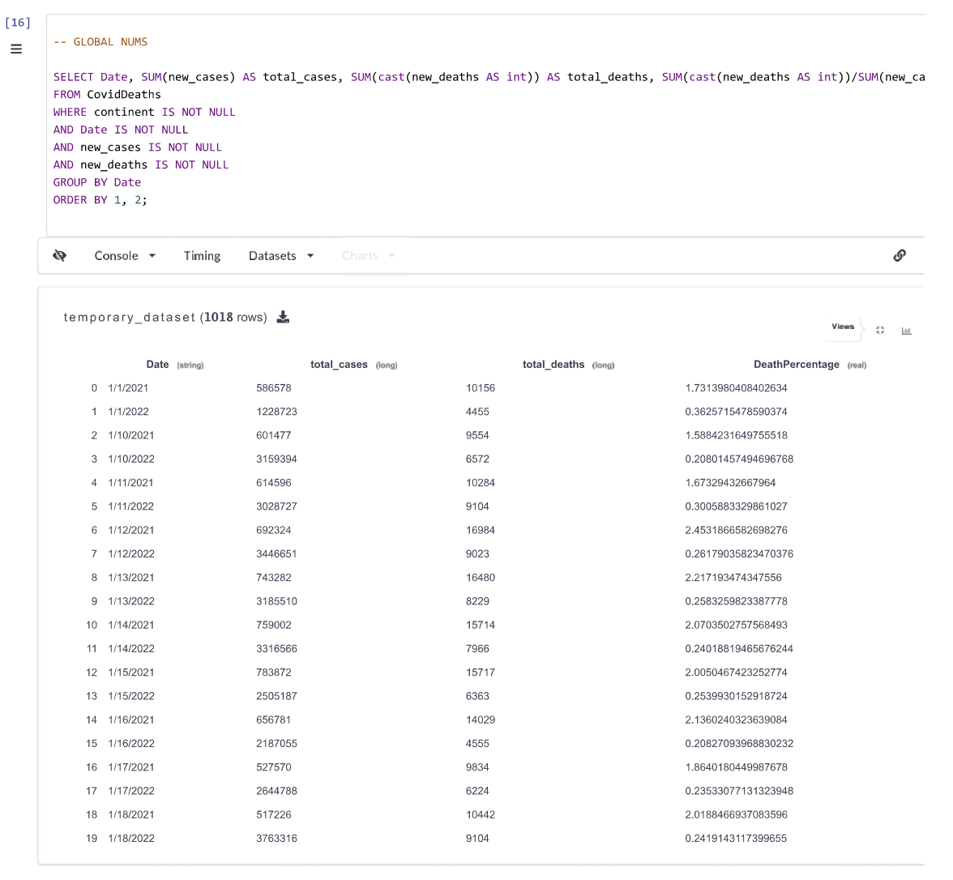
Query No. 11
Query calculates global COVID-19 statistics by summing up new cases and new deaths worldwide from the ‘CovidDeaths’ table. It computes the total number of cases, total deaths, and the death percentage by dividing the total new deaths by the total new cases and multiplying the result by 100. However, the query has an error in the ‘ORDER BY’ clause as aggregate functions like ‘SUM’ cannot be ordered.

Slide 15
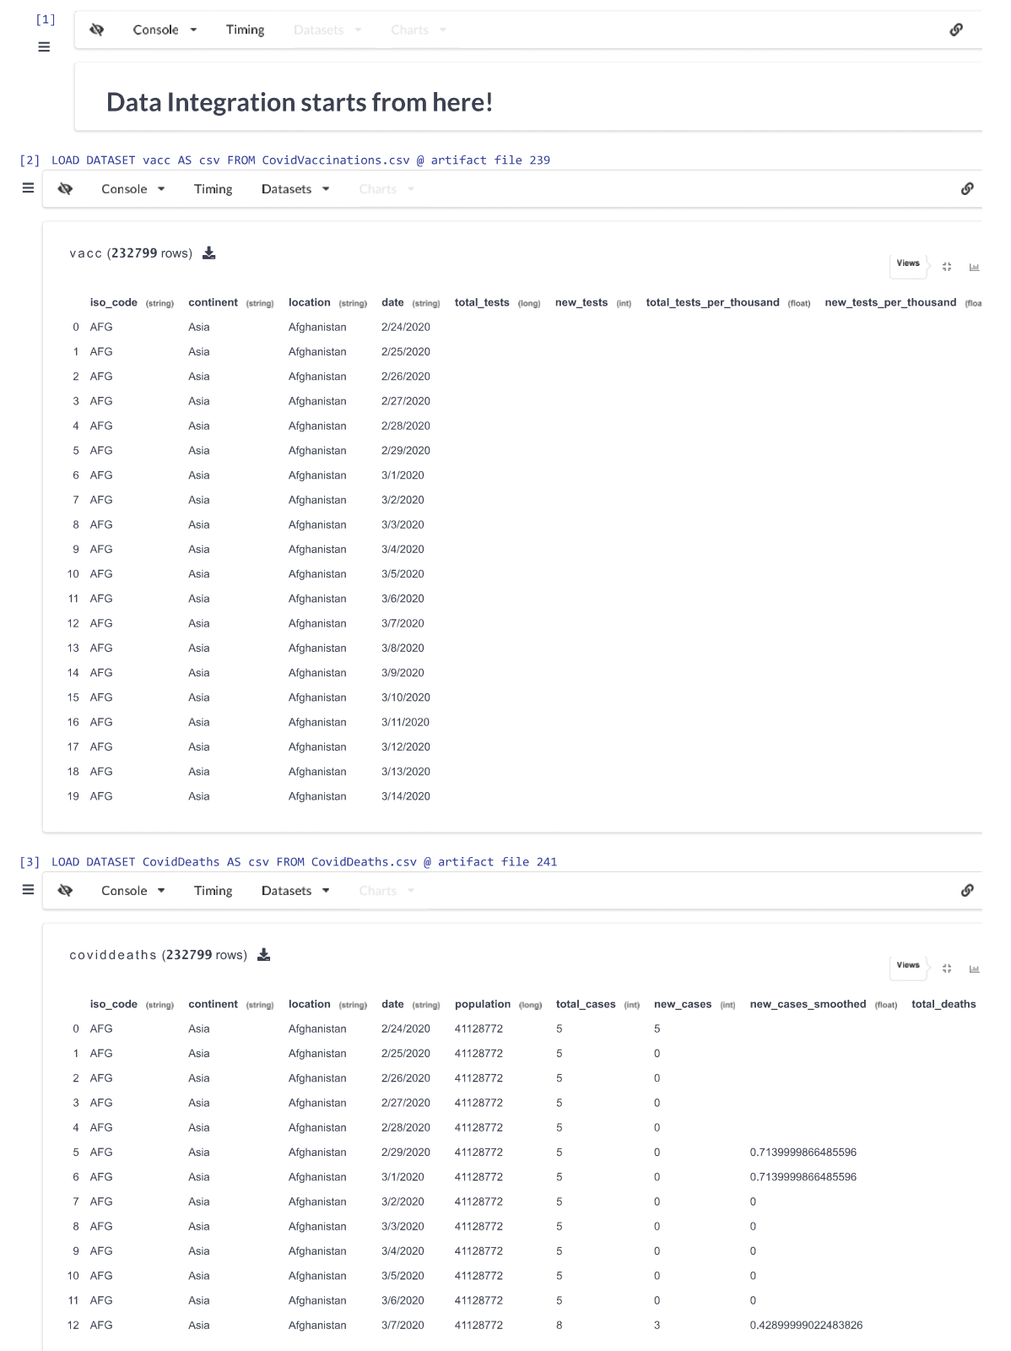
DATA INTEGRATION
Loading 2 Datasets

Slide 16
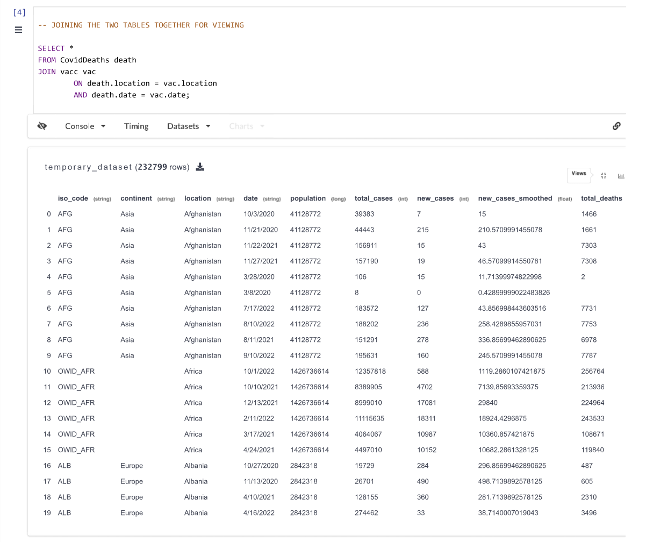
Query No. 12
The query aims to combine information from the ‘CovidDeaths’ table and the ‘vacc’ table, presumably to associate COVID-19 death data (‘CovidDeaths’) with vaccination data (‘vacc’) based on matching locations and dates. The result set would contain columns from both tables for matching location and date pairs.

Slide 17
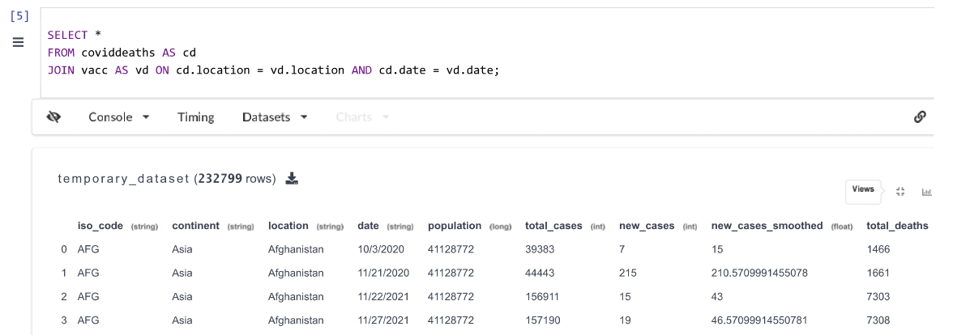
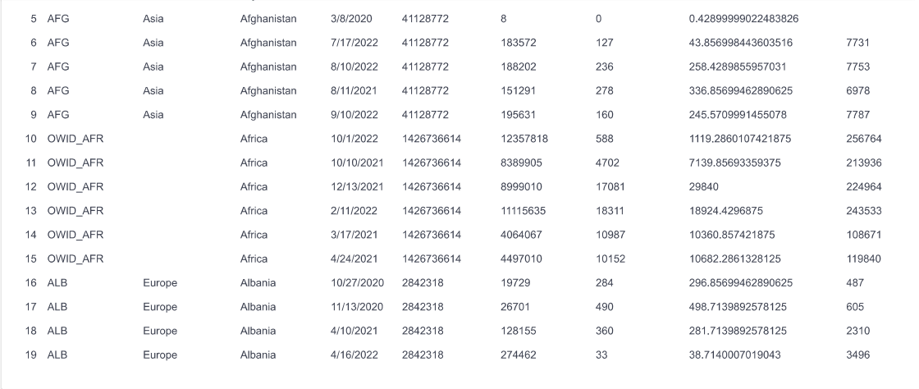
Query No. 13
The query combines information from the ‘coviddeaths’ table and the ‘vacc’ table based on matching location and date pairs. The result set contains columns from both tables for records that have matching location and date values.

Slide 18
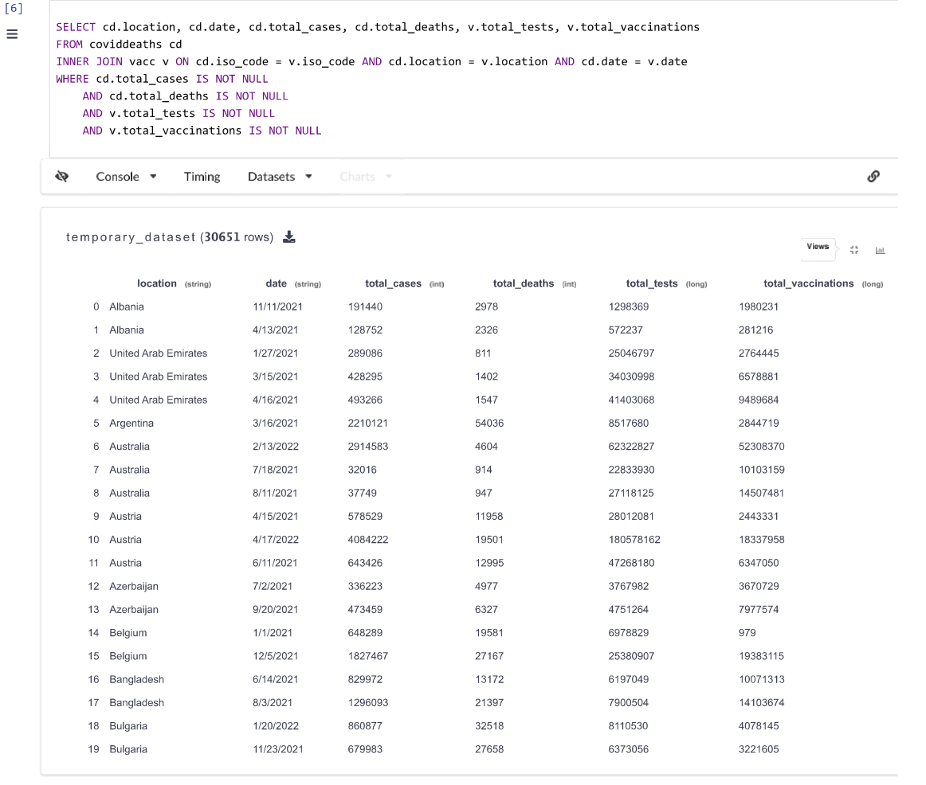
Query No .14
This SQL query performs an inner join between the ‘coviddeaths’ table aliased as ‘cd’ and the ‘vacc’ table aliased as ‘v’. It retrieves specific columns: ‘location’, ‘date’, ‘total_cases’, ‘total_deaths’ from the ‘coviddeaths’ table, and ‘total_tests’, ‘total_vaccinations’ from the ‘vacc’ table.
The query joins these tables based on multiple conditions: - Matching ‘iso_code’, ‘location’, and ‘date’ between the two tables (‘cd’ and ‘v’).
- Filters out records where the ‘total_cases’, ‘total_deaths’ columns in ‘coviddeaths’ table, and ‘total_tests’, ‘total_vaccinations’ columns in the ‘vacc’ table are not null.
The purpose of this query is to retrieve specific COVID-19 data (‘total_cases’, ‘total_deaths’) from the ‘coviddeaths’ table and vaccination data (‘total_tests’, ‘total_vaccinations’) from the ‘vacc’ table where matching records are found based on location, date, and iso_code, while ensuring that these columns have non-null values.

Slide 19
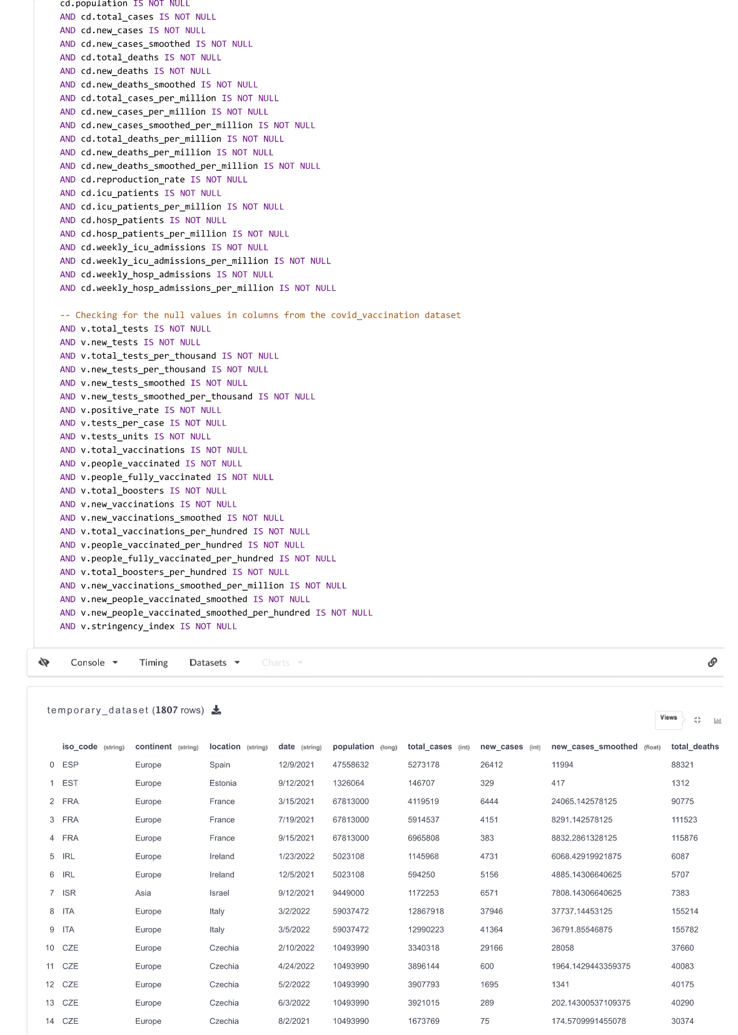
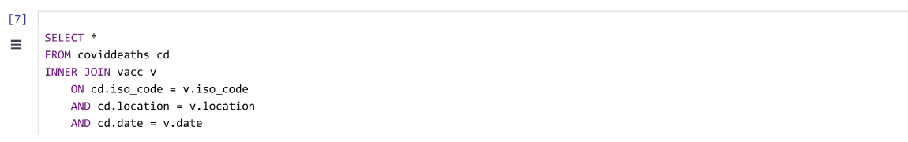
Query No. 15
This SQL query performs an inner join between the ‘coviddeaths’ table (aliased as ‘cd’) and the ‘vacc’ table (aliased as ‘v’). It retrieves all columns from both tables where there is a match on ‘iso_code’, ‘location’, and ‘date’ columns between the two tables.
Additionally, the query includes extensive null value checks for multiple columns from both datasets:
- For columns in the ‘coviddeaths’ table, it verifies that specific columns related to COVID-19 data (such as population, cases, deaths, hospitalization rates, etc.) are not null.
- For columns in the ‘vacc’ table, it ensures that various vaccination-related columns (such as tests, vaccination counts, rates, etc.) do not have null values.

Slide 20
Conclusion
In this project, We have found many issues and solved them using the SQL queries.
We have also performed the data integration and succeeded in performing each and every query very well.

